Slide 1




Content Overview:
Project Overview
Problem Statement
Primary Analysis
Secondary Analysis
Dashboard
Recommendation
Presented By :Saumya Jha

Slide 2


Introduction
In the digital age, streaming services have revolutionized the way we consume movies, shows, and web series. Platforms like LioCinema, and JotStar offer a vast array of entertainment options, catering to diverse audiences worldwide.
OTT platforms are media services offered directly to viewers via the Internet. They bypass traditional distribution methods like cable or satellite television, providing content at the viewer’s convenience. Some popular OTT platforms include Netflix, Amazon Prime Video, and Hulu.
Accessibility
Watch from anywhere with an internet connection.
Variety
: Extensive collections of movies, TV shows, and original content.
On-Demand
Pause, rewind, and play content at your leisure.

Slide 3
Project Overview
LIOCINEMA
JOTSTAR
Liocinema is a leading OTT platform in India which offers a wide variety of movies, tv shows and live sports to it’s audience
Jotsar is a also a leading streaming platform in India offering premium Disney, Marvel, and Star Wars content along with live sports.
Jotstar has a mix of free and paid plans, with premium content behind a paywall.
LioCinema provides a lot of content for free, including IPL,making it a top choice for cricket fans.
Many Lio mobile users get premium access bundled with their communication plans.
Jotstar is more polished with it’s refined user experience and strong recommendations making it more reliable .

Slide 4



Problem Statement
Lio, is a leading telecommunications provider in India, is planning a strategic merger with Jotstar, one of the country’s most prominent streaming platforms. This potential partnership aims to combine LioCinema’s expansive subscriber base and Jotstar’s diverse content library to revolutionize digital streaming in India.
As part of the merger preparation, the management team at Lio wants to analyse the performance and user behavior of both platforms—LioCinema and Jotstar—over the past one year (January to November 2024).
The goal is to gain insights into individual platform performance, content consumption patterns, subscriber growth, Inactivity behavior, upgrade and downgrade trends. The insights derived from this study will help the management make informed decisions and optimize content strategies post-merger, with the ultimate goal of establishing Lio-Jotstar as the leading OTT platform in India.
Go Back to Agenda Page

Slide 5

Goals
Content Library Analysis
Subscriber Insights
Inactivity Analysis
Upgrade Patterns
Downgrade Patterns
Content Consumption Behavior
The insights derived from this comprehensive analysis will enable Lio's management to make informed decisions, optimize content strategies, and position Lio-Jotstar as a formidable competitor in India's OTT market.
Go Back to Agenda Page

Slide 6
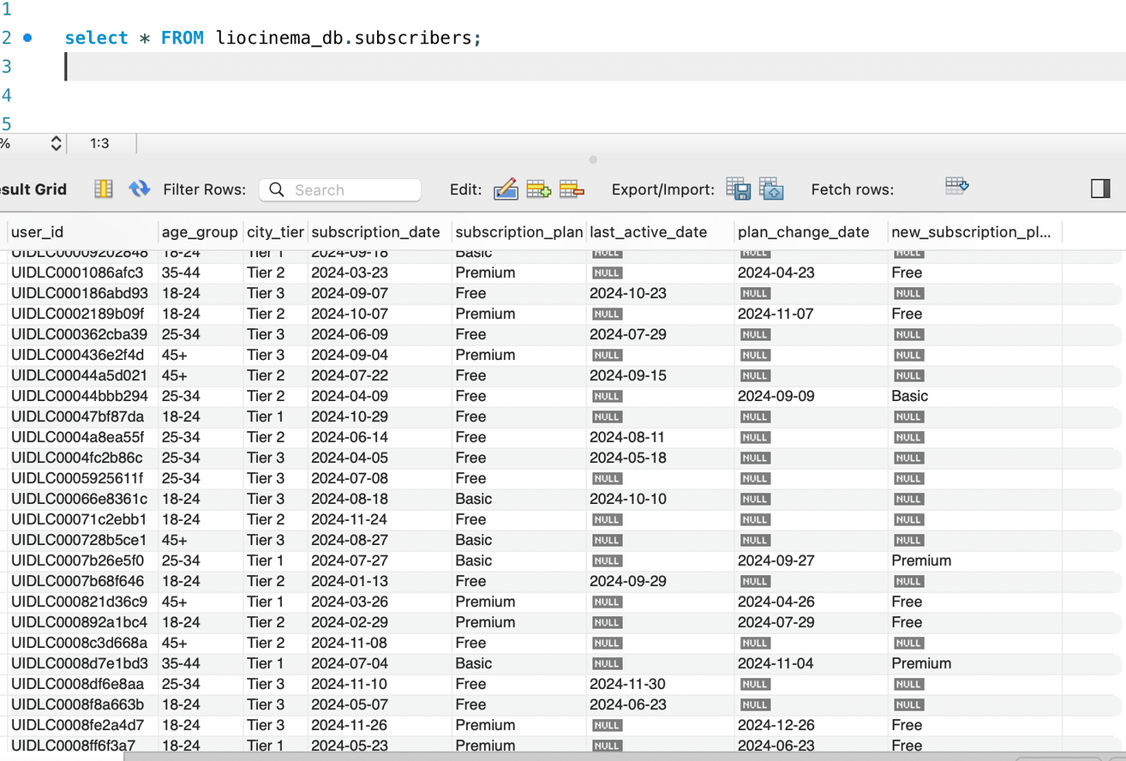
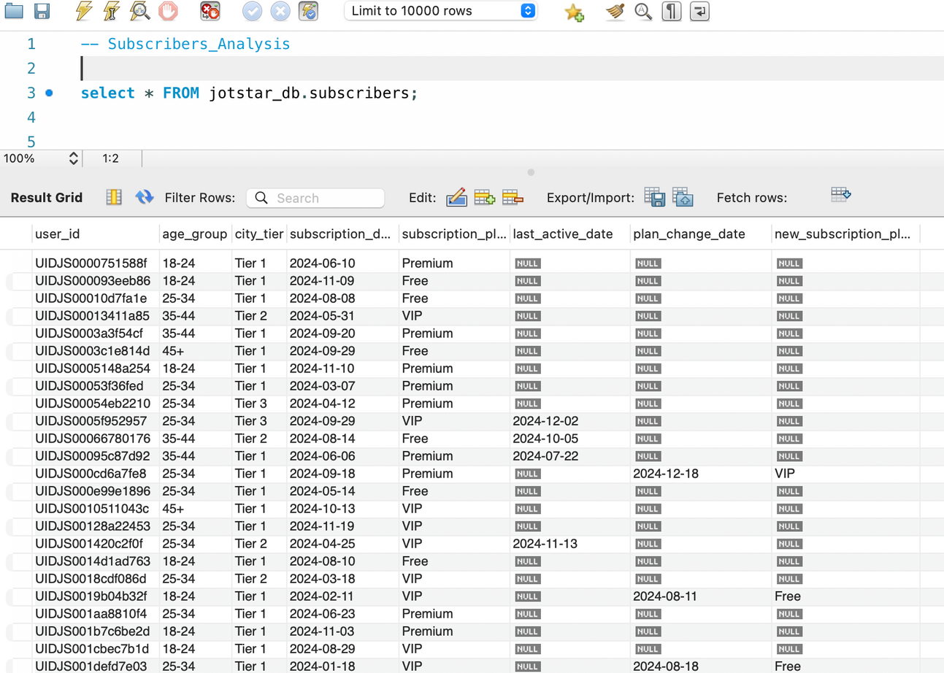

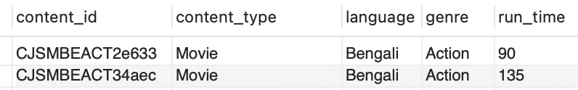
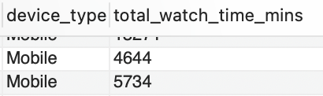
DATASET OVERVIEW
LioCinema_db.sql
Jotstar_db.sql

Slide 7
DASHBOARD

Slide 8
Primary Analysis

Slide 9

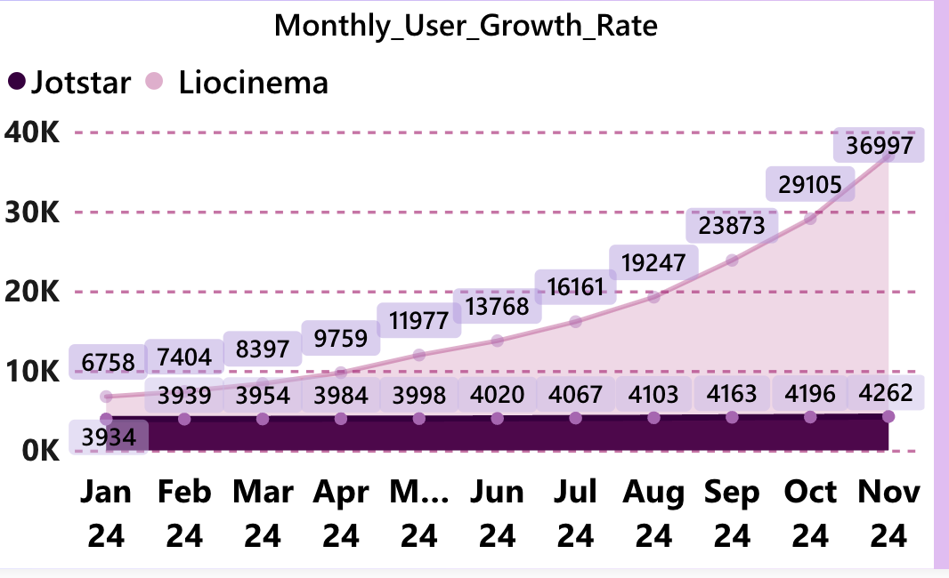
Q.1) What is the total number of users for LioCinema and Jotstar, and how do they compare in terms of growth trends (January–November 2024)?
Key Insight
Liocinema: 183446
Jotstar : 44620
Liocinema experienced exponential user growth, increasing from 6,758 users in January 2024 to 36,997 users in November 2024. This represents a more than 4.5x growth over 11 months.
Jotstar's user base grew from 3,934 in January 2024 to 4,262 in November 2024, reflecting a much slower growth rate compared to Liocinema. The increase of 328 users over 11 months suggests stagnation or limited market expansion.

Slide 10
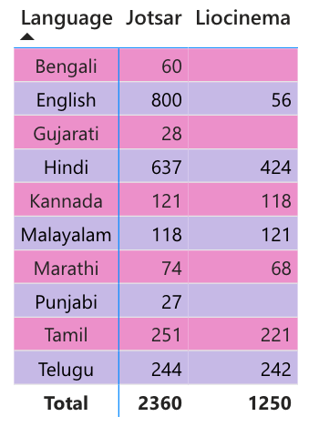
Q.2) What is the total number of contents available on LioCinema vs. Jotstar? How do they differ in terms of language and content type?
Liocinema: 1250
Jotstar : 2360
English has the highest count (800) in Jotsar, significantly surpassing other languages. However, in Liocinema, English has a very low count (56), suggesting that the audience preference for English content is much stronger in Jotsar compared to Liocinema.
Hindi has a strong presence in both Jotsar (637) and Liocinema (424), making it one of the most consistently popular languages across both platforms. This indicates that Hindi content is widely consumed regardless of the platform.

Slide 11

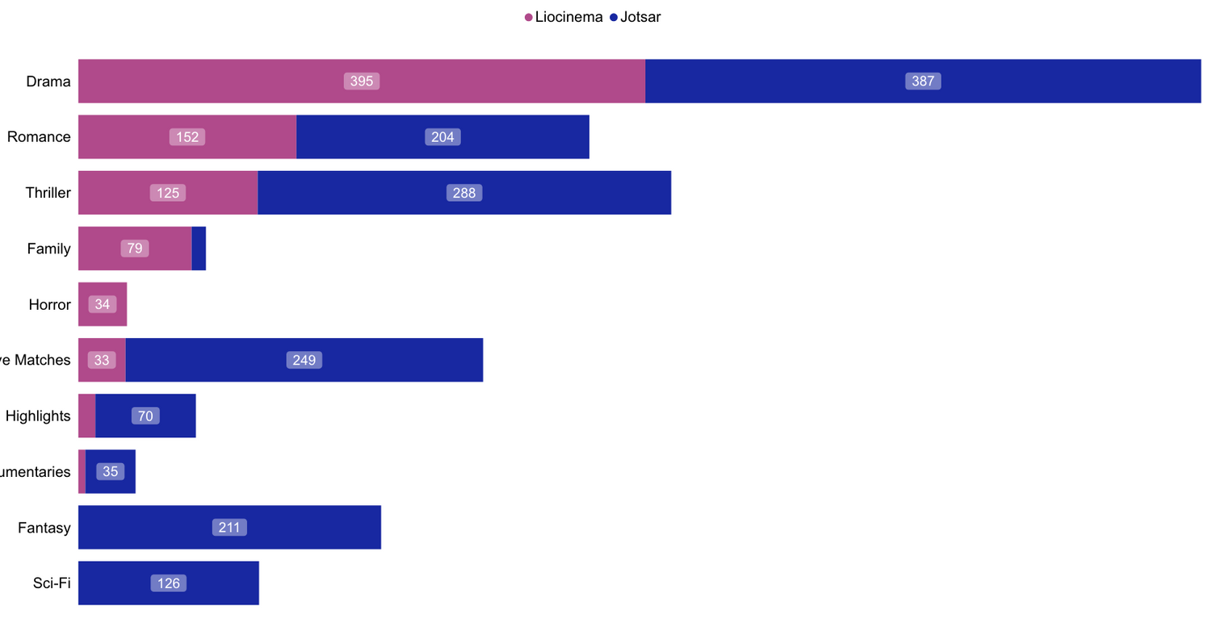
Liocinema: 1250
Key Insight
Jotstar : 2360
In terms of content types both liocinema and jotstar has highest number of content in drama category , followed by romance and thriller .
Jotstar has more diveresed content like fantasy and sci-fi whereas liocinema lacks in this area .

Slide 12
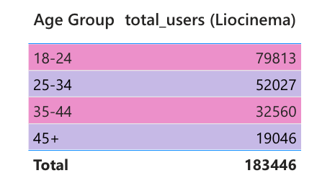
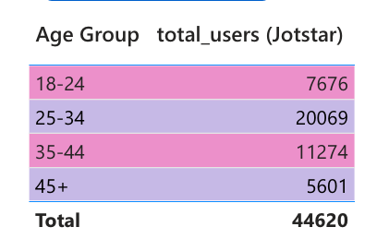
Q.3) What is the distribution of users by age group, city tier, and subscription plan for each platform?
Key Insight
Liocinema has highest number of subscribers between the age of 18-24 whereas jotstar has maximum number of subscribers in agr group of 25- 34
Least number of subscribers fall above the age group of 45 for both the platforms

Slide 13
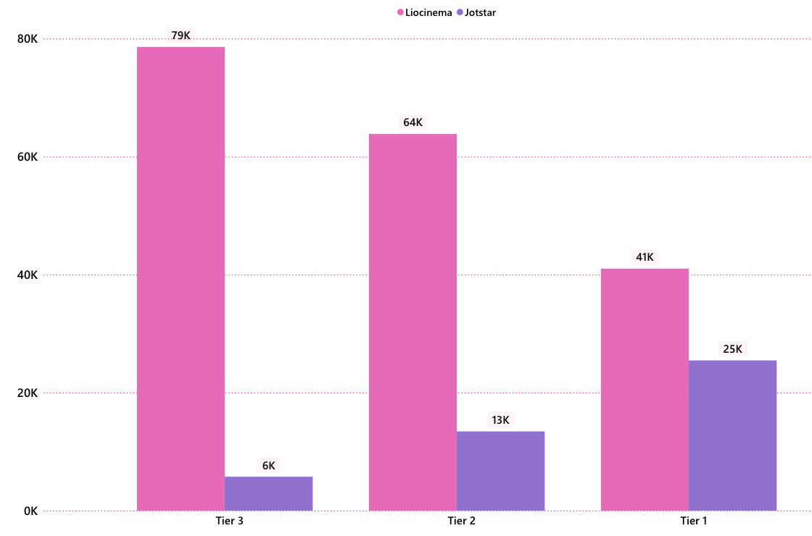
Q.3) What is the distribution of users by age group, city tier, and subscription plan for each platform?
Key Insight
Liocinema has a significantly higher user base than Jotstar across all tiers.
In Tier 3, Liocinema (79K) has over 13 times the number of users compared to Jotstar (6K).
In Tier 2, Liocinema (64K) has nearly 5 times more users than Jotstar (13K).
In Tier 1, the gap is smaller but still significant, with Liocinema at 41K and Jotstar at 25K.
Jotstar performs better in Tier 1 compared to other tiers, reducing the gap with Liocinema.
In Tier 3 and Tier 2, Jotstar lags far behind, but in Tier 1, it captures a much larger share relative to Liocinema.
This indicates that Jotstar might be more competitive in premium segments, while Liocinema dominates the lower tiers.

Slide 14
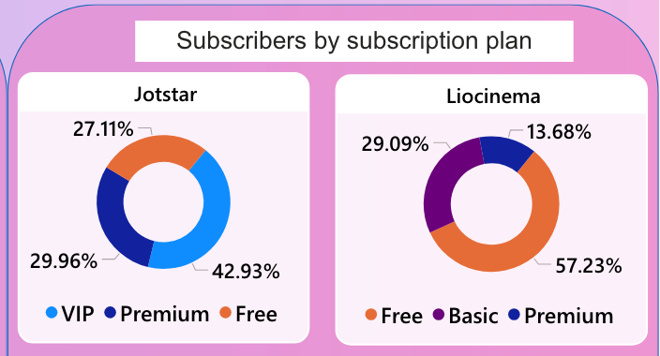
Key Insight
Premium plan distribution shows an inverse pattern between the services. Jotstar has a strong Premium subscription base at 29.96%, whereas Liocinema's Premium tier only accounts for 13.68% of its subscribers. This indicates that Jotstar likely has a more effective premium value proposition or conversion strategy compared to Liocinema, which instead has a substantial Basic tier (29.09%) that doesn't exist in Jotstar's model.
The Free plan has significantly different adoption rates between the two services. While Free subscribers make up only 27.11% of Jotstar's user base, they represent a majority (57.23%) of Liocinema's subscribers. This suggests that Liocinema relies more heavily on its free tier to attract users, while Jotstar has been more successful at converting users to paid plans.

Slide 15
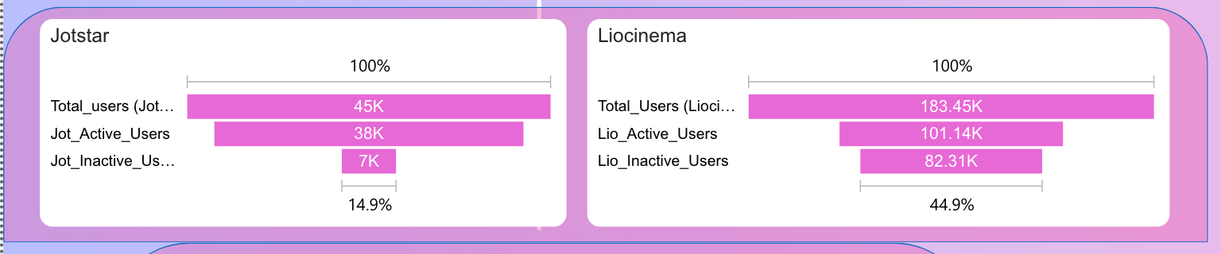
Q.4) What percentage of LioCinema and Jotstar users are active vs. inactive? How do these rates vary by age group and subscription plan?
Jotstar has only 14.9% inactive users (7K out of 45K total), while Liocinema has a concerning 44.9% inactive users (82.31K out of 183.45K total). This suggests Jotstar is significantly more successful at engaging its user base, with nearly 85% of users remaining active compared to only about 55% for Liocinema.
Despite Liocinema having over 4 times the total user count (183.45K vs 45K), both platforms have relatively comparable active user numbers (101.14K vs 38K). This indicates that Jotstar may be offering better value or user experience, as it maintains a much higher percentage of active users with a much smaller total user base.

Slide 16
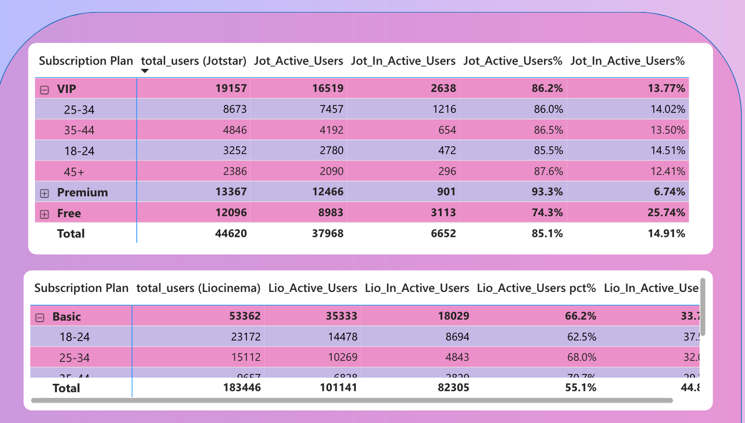
The 45+ age group shows the highest activity rate (87.6%) among VIP subscribers, while younger users (18-24) have slightly lower engagement at 85.5%. This indicates the service might be particularly valuable to older demographics, despite having a smaller user base of 2,386 compared to 8,673 users in the 25-34 age group.
Premium subscribers have the highest activity rate at 93.3%, significantly outperforming both VIP (86.2%) and Free users (74.3%). This suggests that premium subscribers receive the most value from the service, while free users are nearly 4 times more likely to be inactive (25.74% inactive vs 6.74% for premium).
Age is strongly correlated with activity rates on Liocinema, with engagement progressively improving with age. The 18-24 age group has the lowest activity rate at 62.5%, while older groups show better engagement. This pattern suggests that Liocinema's content or features might not resonate with younger audiences, representing the largest segment (23,172 users) of their Basic subscription tier.

Slide 17
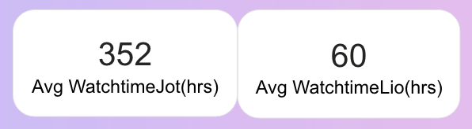
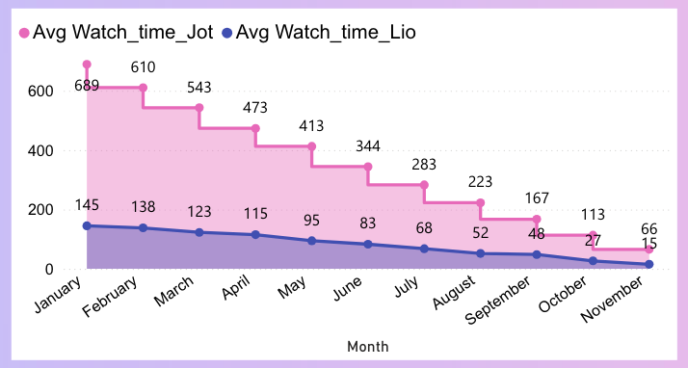
Q.5) What is the average watch time for LioCinema vs. Jotstar during the analysis period? How do these compare by city tier and device type?
Massive engagement disparity: Jotstar users watch nearly 6 times more content (352 hours) than Liocinema users (60 hours), indicating a substantial difference in content engagement or platform stickiness.
Declining engagement for both platforms: Both platforms show consistent month-over-month declines in watch time from January to November, with Jotstar dropping from 689 hours to 66 hours and Liocinema from 145 hours to 15 hours.

Slide 18
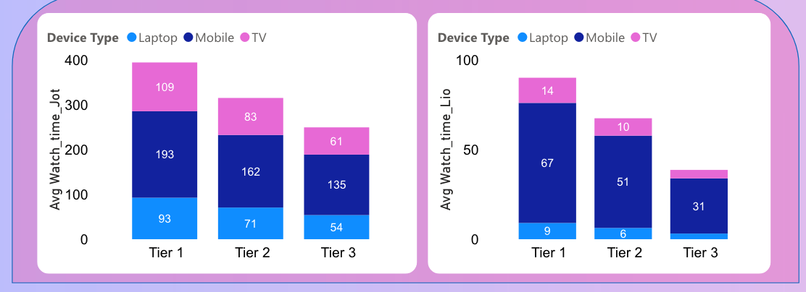
Mobile dominates across all tiers: Mobile devices account for the highest watch time in both platforms, with Jotstar seeing 193 hours for Tier 1 users compared to 67 hours for Liocinema.
TV usage declines with tier level: For both platforms, TV viewing represents a smaller portion of time as tier level decreases, suggesting premium subscribers are more likely to engage with content on larger screens. Jotstar's Tier 1 shows 109 hours of TV viewing compared to just 61 hours for Tier 3.
Tier correlation with watch time: For both platforms, higher tiers (Tier 1) consistently show significantly more watch time across all device types, with Jotstar's Tier 1 users watching nearly 400 hours compared to Tier 3's 250 hours.

Slide 19
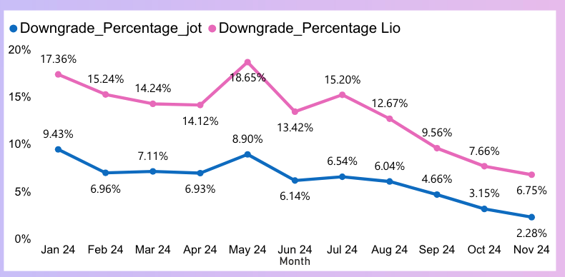
Q.6) How do downgrade trends differ between LioCinema and Jotstar? Are downgrades more prevalent on one platform compared to the other?
Yes, based on the chart, downgrades are significantly more prevalent on the "Lio" platform compared to the "jot" platform. The pink line representing "Lio" consistently sits well above the blue line representing "jot" throughout the entire timeline shown. This visual clearly indicates a higher downgrade percentage for Lio in every corresponding month.
Lio consistently experiences a higher downgrade percentage than jot throughout the entire period.This indicates that at any given month, the downgrade percentage for Lio is significantly higher than that of jot.

Slide 20
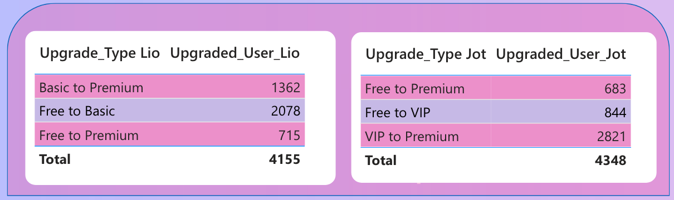
Q.7)What are the most common upgrade transitions (e.g., Free to Basic, Free to VIP, Free to Premium) for LioCinema and Jotstar? How do these differ across platforms?
Lio users prefer upgrading in a stepwise manner and the highest count is from Free to Basic (2078 users)which is followed by Basic to Premium (1362 users).
Jot users, on the other hand, mostly upgrade directly to Premium from VIP (2821 users), indicating a possibly more premium-seeking or loyal user base.

Slide 21
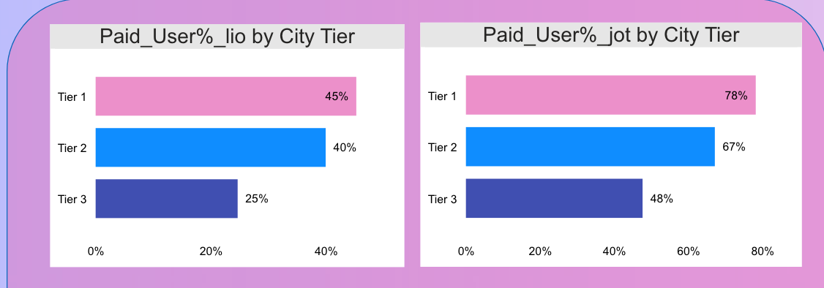
Q.8) How does the paid user percentage (e.g., Basic, Premium for LioCinema; VIP,
Premium for Jotstar) vary across different platforms? Analyse the proportion of premium users in Tier 1, Tier 2, and Tier 3 cities and identify any notable trends or differences.
Both Jot and Lio show a decreasing percentage of paid users as city tiers progress from Tier 1 to Tier 3. This indicates a general trend of lower paid user penetration in less economically developed or smaller cities, suggesting a potential challenge in monetizing users in these areas.
Jot has a significantly higher percentage of paid users across all city tiers compared to Lio. This suggests Jot is more effective at converting users to paid subscriptions, regardless of the city's economic tier.

Slide 22
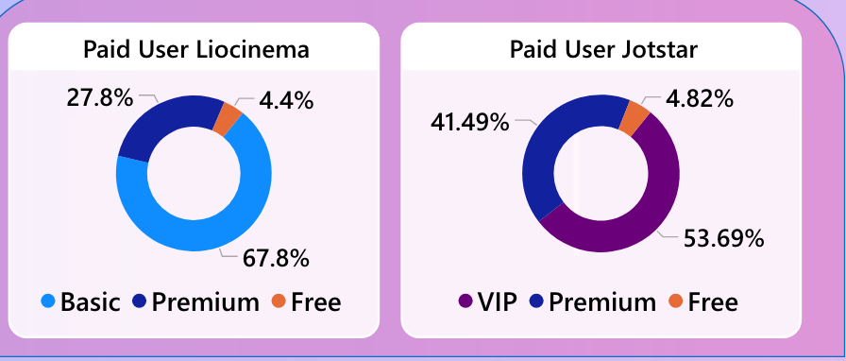
Jotstar has a higher concentration of VIP users (41.49%) compared to Liocinema's Premium users (67.8%). This suggests a potentially more engaged or higher-value user base for Jotstar.
Both platforms have a small percentage of Free users (around 4.5-4.8%), indicating a strong focus on paid subscriptions. This highlights a business model reliant on converting users to paid tiers.

Slide 23
Secondary Analysis

Slide 24
Q.1) What strategies can the merged platform implement to increase engagement among inactive users and convert them into active users?
Ans:
Use personalized AI powered recommendations based on past viewing history to show contents users are more likely to watch
Create bite-sized episodes or recaps for users who find long content overwhelming.
Introducing loyalty programs where users earn points for watching content and redeem it during their next purchase
Introducing loyalty programs where users earn points for watching content and redeem it during their next purchase
Introducing loyalty programs where users earn points for watching content and redeem it during their next purchase
To make it’s own original shows like amazon prime and netflix

Slide 25
Q.2) What type of brand campaigns should the merged platform launch to establish itself as the go-to OTT platform in India?
Ans - Marketing Campaigns can make or break a company and to establish the newly merged OTT platform as India’s #1 streaming destination, we need a mix of viral, interactive, and emotion-driven marketing strategies. Here are some unique campaign ideas:
1) India Ka Apna OTT – Localization & Cultural Connection
2) Reality Se Real Takk – Focus on Unique & Diverse Content
3) StreamOnTheGo – Target Mobile & Tier 2-3 Cities
4)Rewind India – Nostalgia-Driven Content for Millennials & Gen X
5) Cross Brand Collaboration - Collabing with telecom companies, food delivery and e - commerce apps to enhance user engagement .
6) Festival Based Themes - Discounted price on certain festivals and new content release .

Slide 26
Q.3) How should the merged platform price its subscription plans to compete effectively while maintaining profitability?

Slide 27


Pricing Strategies
Streaming Quality
Screen Supported
Plan
Pricing
Ads
Basic
₹99/month
1080p (Full HD)
1 (Mobile Only)
Yes
Standard
₹199/month
2K Quality
2 Screens
Yes
Premium
₹499/month
4K Ultra HD
4 Screens
No
Annual
₹1299/month
4K Ultra HD
4 Screens
No

Slide 28
Basic Plan (₹99/month) – Mass Appeal & Ad Revenue
Affordable mobile-only access with 1080p quality to attract price-sensitive users.
Ad-supported model ensures revenue while keeping the entry cost low.
Growth Impact: Expands the user base and increases engagement.
Standard Plan (₹199/month) – Better Experience & Multi-Screen Use
Ad-free viewing with two screens, ideal for small families.
Growth Impact: Encourages upgrades, improving customer retention.
Premium Plan (₹499/month) – High-End Viewers & 4K Quality
4K streaming & four screens for premium users.
Growth Impact: Boosts ARPU and strengthens the platform’s premium positioning.
Annual Plan (₹1299/year) – Long-Term Retention
All premium features at a discounted price, reducing churn.
Growth Impact: Increases customer lifetime value (CLV) and ensures steady revenue.

Slide 29
Q.4) How can the platform leverage partnerships with telecom companies to expand its subscriber base?
OTT-First SIM Cards – Introducing special SIM cards designed for entertainment lovers, offering exclusive access to the platform with high-speed streaming benefits and dedicated customer support.
Exclusive Content Access for Telecom Users – Offering early access to shows, live sports, or exclusive content for users of a particular telecom network can drive sign-ups and increase engagement.
Unique Data Packs for Streaming, that can offer unlimited streaming on the platform which will encourage more users to subscribe without worrying about data consumption.
Introducing a watch now , pay later scheme where users can continue to watch their favourite content even after their data pack is over with payment being deducted over next recharge

Slide 30
Q.5)What role can AI and machine learning play in personalizing the user experience and improving content discovery?
Context-Aware Recommendations –
ML analyzes time of day, location, and device type to suggest suitable content—short videos for commutes, long movies for home viewing.
Mood-Based Content Curation –
AI detects user emotions (via facial recognition or interaction patterns) and suggests content based on their mood—relaxing, thrilling, or feel-good.
AI-Powered Visual Search – Users can upload an image or describe a scene, and AI will find matching content, revolutionizing search functionality.
Smart Recommendations – AI analyzes user preferences, watch history, and behavior to suggest tailored content.

Slide 31

Q.6) Who should be the brand ambassador for the newly merged OTT platform (LioCinema-Jotstar) to effectively represent its identity and attract a diverse audience?
Massive Fan Following –
Shah Rukh Khan enjoys a global fan base, spanning across India, the Middle East, and even Western countries. His association with the merged platform will immediately boost visibility and attract a large audience.
Strong Digital Presence –
With millions of followers on social media, SRK’s promotional campaigns can create massive engagement and organic reach, making the platform more recognizable.
Connection with Every Generation-
From the 90s to the present, SRK has remained relevant across different generations, making him the perfect face to appeal to both older and younger audiences.
Shahrukh khan

Slide 32
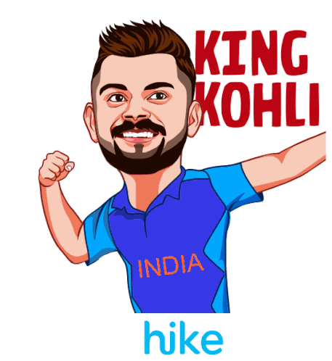
Massive Fan Base & Popularity –
Virat Kohli is one of the most recognized sports personalities, with a huge following in India and worldwide. His association would naturally draw sports lovers to the platform.
Strong Connect with Fitness & Sports Enthusiasts –
Known for his passion for fitness and excellence in cricket, Kohli resonates with audiences who actively follow sports content, making him a perfect fit for promoting live matches, documentaries, and sports-related shows.
Authenticity & Engagement –
Kohli’s credibility as a top athlete, combined with his high social media influence, ensures that his endorsement will create a deep connection with audiences, boosting engagement and subscriptions
Virat Kohli

Slide 33
Conclusion :-
To fully capitalize on this merger, the newly formed entity should focus on content diversification, personalized recommendations, and strategic pricing models.
By leveraging advanced data analytics, I got deeper insights into viewer preferences, content offerings and customer retention. Additionally, optimizing marketing strategies and exploring bundling options with telecom providers or smart TV manufacturers can enhance user acquisition.
By integrating the strengths of both platforms, Liocinema and Jotstar can not only expand their market reach but also drive long-term profitability in the evolving digital entertainment landscape.

